Slide 1
Higher Quality Software Through Automated Refactoring Techniques
Simon Baars
Friday 9 August
Notes:
Introduce yourself
Introduce topic

Slide 2
Why this subject?
SIG viewpoint
Notes:
There is a definite opportunity in assisting client in the refactoring process. However, this opens up new problems: what if the code breaks?
From an SIG viewpoint: We want to improve the codebases of our clients. We do this by offering detailed insights into the quality of their codebases. We give our clients reports with concrete action points about what they should do to improve. This way we try to avoid that our clients end up with unmaintainable code.

Slide 3
Why this subject?
Personal perspective
Notes:
From my personal viewpoint, I got a lot of interest in this topic from my history in programming. When I was 14 I started programming in Java by modifying the Minecraft source code. I created several extensions for Minecraft, one of which is displayed here. This is an extension I created where you could tame a pig and put a helmet on their hats for them to fight for you. These extensions got quite popular, exceeding millions of downloads and views.

Slide 4
Why this subject?
Personal perspective
Notes:
Then, as Minecraft was updated, I had to periodically revisit these extensions to update them as well. However, due to the worse code I created because of not knowing any design best practices, I was unable to update many. Of over 20 extensions I created, only one still works as of today. The main reason it still works, is that it’s my most popular extension and I’ve invested a lot of time into refactoring this codebase.

Slide 5
What is refactoring?
Improving code quality without changing the functional behavior
Notes:
So I started to refactor my code, but I noticed that there was a lot of repeated work in there. Everything I did wrong, I also did wrong in hundreds of other places. So fast forward to January. In this month I had to come up with a topic for my thesis. During this month, I had been looking through many possible subjects for my thesis. In the end, SIG agreed for me to do a project of my own choosing, in which I look into the opportunities to automatically refactor code based on the SIG maintainability metrics.

Slide 6
Refactoring
Unit Interface Size
Notes:
So I started to refactor my code, but I noticed that there was a lot of repeated work in there. Everything I did wrong, I also did wrong in hundreds of other places. So fast forward to January. In this month I had to come up with a topic for my thesis. During this month, I had been looking through many possible subjects for my thesis. In the end, SIG agreed for me to do a project of my own choosing, in which I look into the opportunities to automatically refactor code based on the SIG maintainability metrics.

Slide 7
Refactoring
Complexity
Unit Size
Unit Interface Size
Notes:
So I started to refactor my code, but I noticed that there was a lot of repeated work in there. Everything I did wrong, I also did wrong in hundreds of other places. So fast forward to January. In this month I had to come up with a topic for my thesis. During this month, I had been looking through many possible subjects for my thesis. In the end, SIG agreed for me to do a project of my own choosing, in which I look into the opportunities to automatically refactor code based on the SIG maintainability metrics.

Slide 8
Refactoring
Duplication
Complexity
Unit Size
Unit Interface Size
Notes:
So I started to refactor my code, but I noticed that there was a lot of repeated work in there. Everything I did wrong, I also did wrong in hundreds of other places. So fast forward to January. In this month I had to come up with a topic for my thesis. During this month, I had been looking through many possible subjects for my thesis. In the end, SIG agreed for me to do a project of my own choosing, in which I look into the opportunities to automatically refactor code based on the SIG maintainability metrics.

Slide 9

Refactoring
Duplication
Complexity
Unit Size
Unit Interface Size
Notes:
So I started to refactor my code, but I noticed that there was a lot of repeated work in there. Everything I did wrong, I also did wrong in hundreds of other places. So fast forward to January. In this month I had to come up with a topic for my thesis. During this month, I had been looking through many possible subjects for my thesis. In the end, SIG agreed for me to do a project of my own choosing, in which I look into the opportunities to automatically refactor code based on the SIG maintainability metrics.

Slide 10
Refactoring
Duplication
Complexity
Unit Size
Unit Interface Size
Notes:
So I started to refactor my code, but I noticed that there was a lot of repeated work in there. Everything I did wrong, I also did wrong in hundreds of other places. So fast forward to January. In this month I had to come up with a topic for my thesis. During this month, I had been looking through many possible subjects for my thesis. In the end, SIG agreed for me to do a project of my own choosing, in which I look into the opportunities to automatically refactor code based on the SIG maintainability metrics.

Slide 11
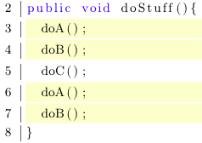
Automatically improving code quality metrics
Notes:
So, duplicating code is bad. It can significantly increase the volume of a codebase and thus the amount of maintenance work required. Additionally, there is an implicit dependency between two pieces of code. In this example, we see duplicate code in a method. This method is basically a set of computer instructions executed sequentially.

Slide 12
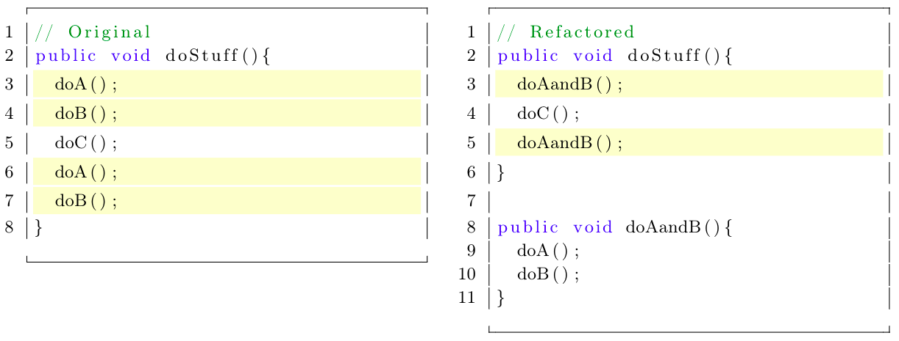
Automatically improving code quality metrics
Notes:
So, duplicating code is bad. It can significantly increase the volume of a codebase and thus the amount of maintenance work required. Additionally, there is an implicit dependency between two pieces of code. In this example, we see duplicate code in a method. This method is basically a set of computer instructions executed sequentially.

Slide 13
Automatically improving code quality metrics
?
Notes:
For SIG: can we tool assist the client in refactoring their codebases in a less error prone way?
So the question I started with is: can we train a computer to automatically improve the maintainability of a codebase. Please note that I’m not only talking about the SIG stars, but the actual maintainability. Of course, there are ways to manipulate a codebase to make it seem like it has a high star rating, but my thesis is focused on actual improvement. When I started this thesis I saw definite opportunities to do such a thing. However, as I got further into the process I noticed that it entails a lot of complexity I did not anticipate. Because of that, I decided to focus on the automated improvement of a single metric: duplication.
There is a definite opportunity in assisting client in the refactoring process. However, this opens up new problems: what if the code breaks?
From an SIG viewpoint: We want to improve the codebases of our clients. We do this by offering detailed insights into the quality of their codebases. We give our clients reports with concrete action points about what they should do to improve. This way we try to avoid that our clients end up with unmaintainable code.

Slide 14
Automatically improving code quality metrics
?
Notes:
So, duplicating code is bad. It can significantly increase the volume of a codebase and thus the amount of maintenance work required. Additionally, there is an implicit dependency between two pieces of code. In this example, we see duplicate code in a method. This method is basically a set of computer instructions executed sequentially.

Slide 15
Automatically improving code quality metrics
?

Slide 16
CloneRefactor
Detect Clones
Map Context
Refactor
Notes:
So, to automatically solve duplication issues I developed a tool throughout my thesis period. This tool basically goes through three steps.

Slide 17
CloneRefactor
Detect Clones
Map Context
Refactor
Merge
Original codebase
Refactored code
Notes:
Mother tidied room: what changed? Mother copied room and I can choose what changes she made I accept.

Slide 18
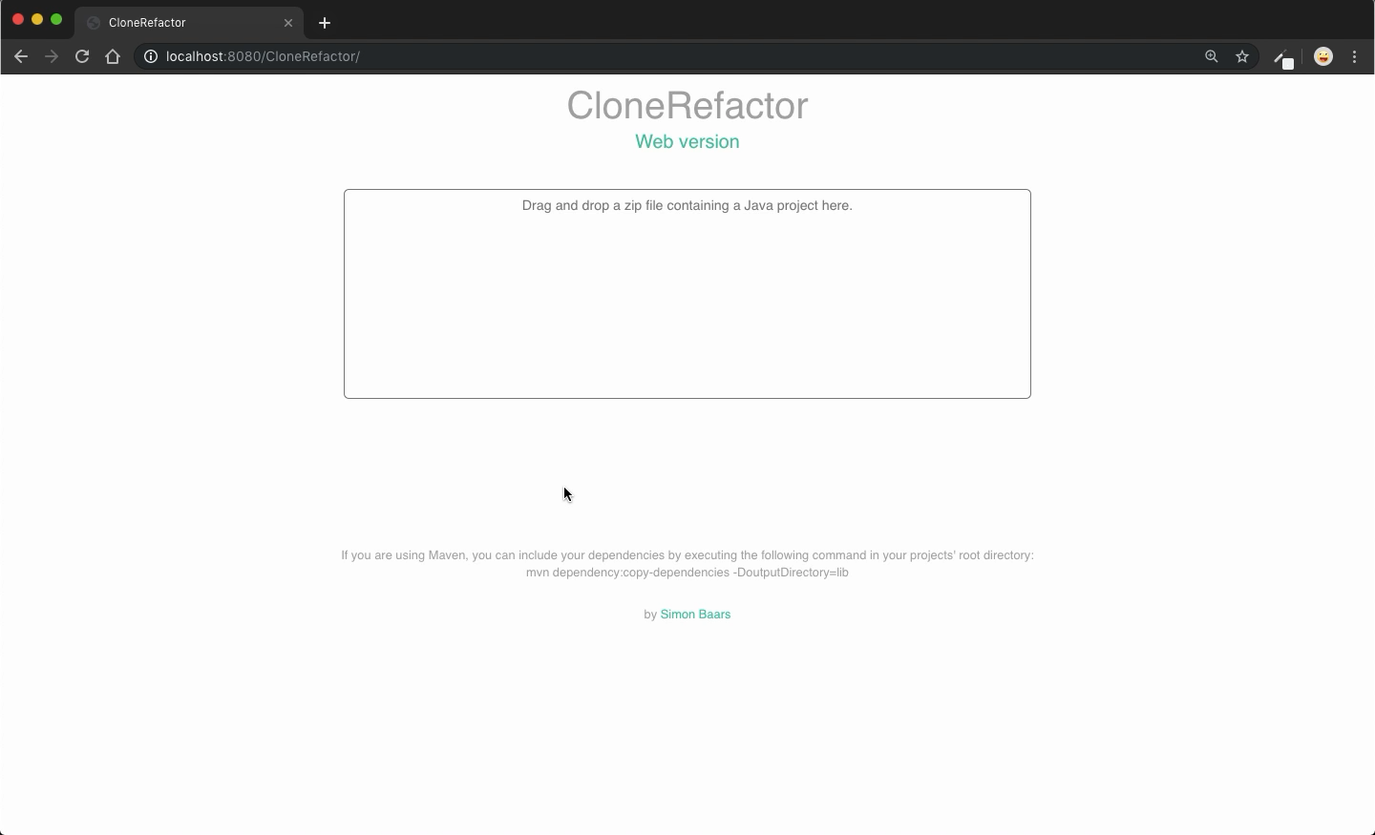
Demo
Notes:
If your boss pays you per commit, profit.

Slide 19
Concluding remarks
Automatic improvement – yay or nay?
More technical details?
28th 9:00 thesis defense at UvA
30th thesis presentation at SIG
Contact me ☺
s.baars@sig.eu
Notes:
Programming language specific
Many edge cases to consider
YAY! Error margins smaller and huge time gain,
If you want to read through my thesis when its finished, contact me and I’ll send it.

